Slide 1
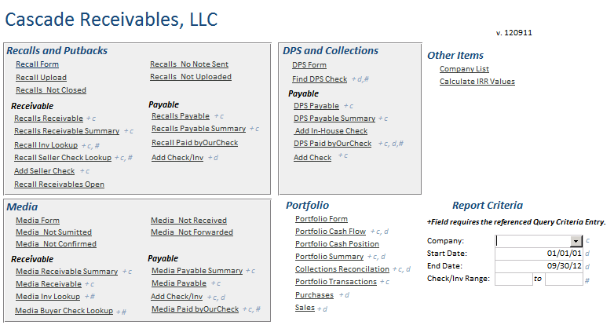
REPORTS needed are in blue boxes

